Slide 1

DriverPass System Analysis
Kevin Raddatz
Notes:
[No speaker notes required for this slide.]

Slide 2

System Requirements
•The System shall allow users to take online classes in relation to driving.
•The system shall allow the customer to make and edit appointments.
•The system needs to run in a web-based environment.
•System should be updated when new DMV requirements are released.
Notes:
Functional Requirements: Taking online classes for driving, Allow user to make and edit appointments
Nonfunctional requirements: Running in a web-based environment, System should be updated when new DMV requirements are released.
DriverPass’ main goal is to create an environment where a user can take driving lessons online and make appointment for on road lessons.
The System needs to be easily accessible to a wide base of users (hence web based) and be updated with the newest driving regulations from the Drivers state
Department of Motor Vehicles.

Slide 3
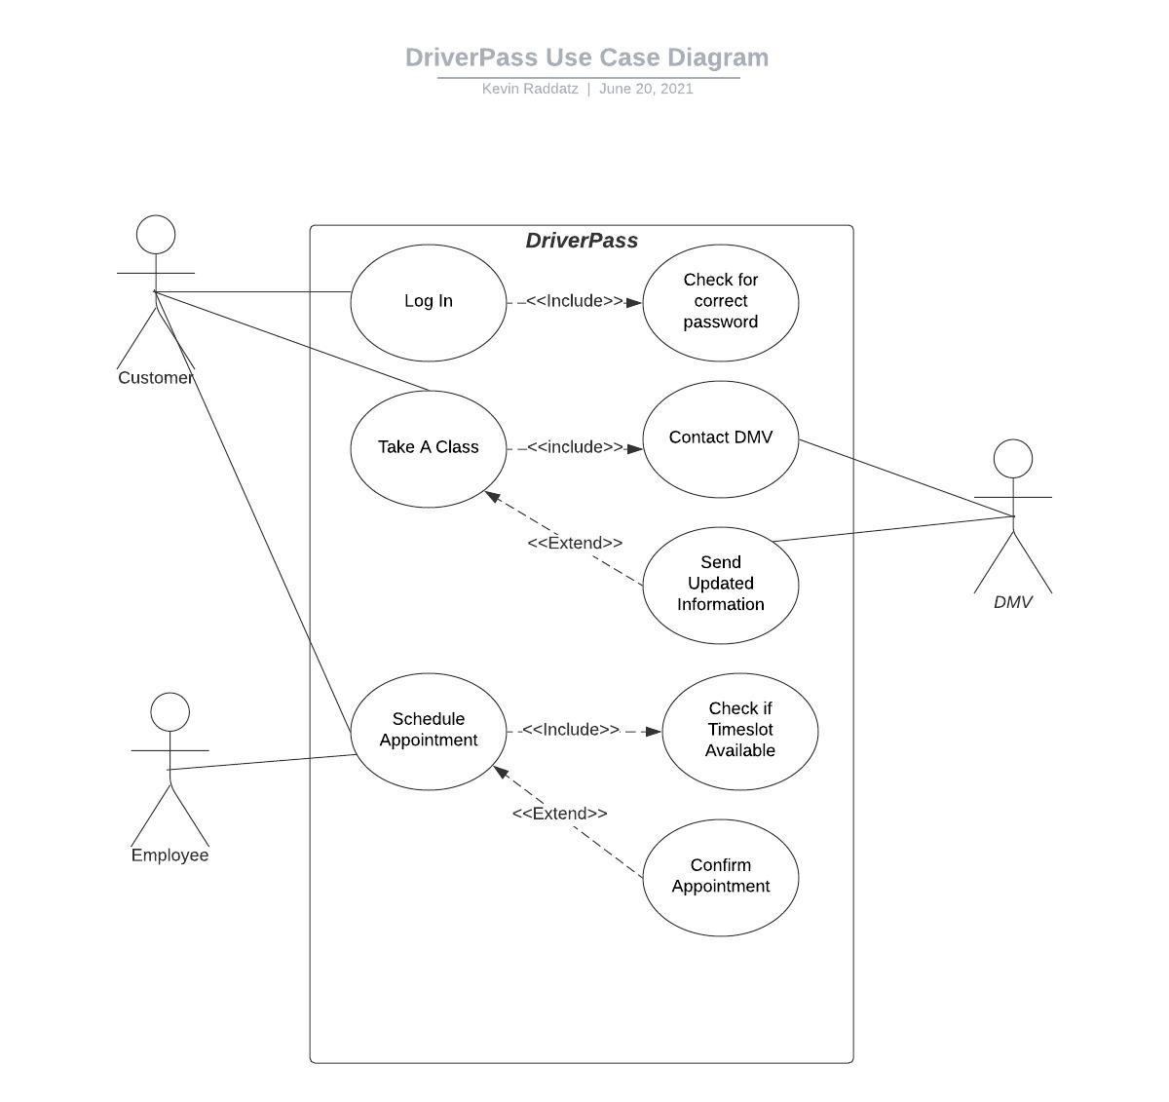
Use Case Diagram
Notes:
There are Three main use cases with a secondary case for each one. For this system, there are three actors. The Customer and DriverPass employees are the primary actors, while the DMV is a secondary actor. The use cases in this diagram allow the users to log into the system, take a class on DriverPass, and schedule an appointment for a driving lesson.
Log in: Will check for correct username/password and allow login if things are correct
Take a Class: Keeps up with Changes at DMV, if there are changes the changes will be reflected in the class
Schedule Appointment: Check if appointment time/date is available and confirm appointment if available

Slide 4
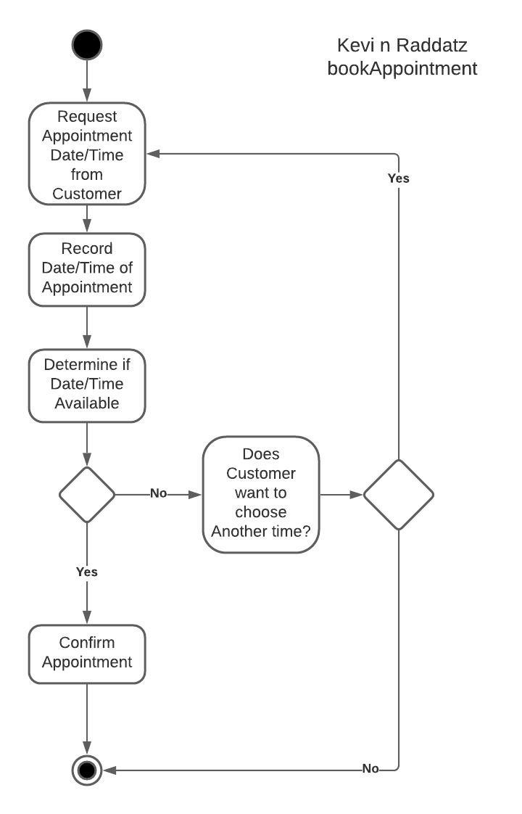
Activity Diagram
Notes:
The Use case described here is booking an appointment. The user will request an appointment time, the time and date will be recorded (either by the DriverPass employee or the computer system).
IF: Appointment Time is available, the user will have the appointment confirmed
ELSE: If the appointment time is unavailable, User will have the option to either choose another time or
End the process.

Slide 5
Security
Password Secured Accounts
DriverPass IT Administration control Permissions given to users
DriverPass IT Administration Can control password maintenance
User Accounts Locked after Five (5) incorrect password attempts.
User accounts must be reset by DriverPass IT Admin
Notes:
Users will require a password secured and verified account
A user will be allowed Five incorrect password attempts before the account must be reset by DriverPass IT Admin
DriverPass administration will control the permissions given to individual user in order to avoid giving too much/too little access
IT Admin will own security for the system,

Slide 6
System Limitations
Devices must be connected to the internet.
Time is limited to roughly three months.
Device must have power for System to function.
Devices must have a compatible browser installed.
Notes:
A Web based Application will require Access to the internet to function
Development time for the system is limited to Three months, limiting the functionalities that can be implemented.
A device that is powered off will not be able to access the system.
A Compatible Internet browser will be required. Examples: Safari, Chrome, Firefox, Etc.

